Slide 1
Advanced Network Systems CSCI 6170
Lecture 18 – Network Layer (Control Plane)
Fall 2024
Md Rumman Rafi
Department of Computer Science & Information Systems
Auburn University @ Montgomery
AL USA

Slide 2
Attendance

Slide 3
Agenda
Review of Previous Lecture
Today’s Lecture
Questions

Slide 4
Review of Previous Lecture

Slide 5

Network layer: “data plane” roadmap
Network layer: overview
data plane
control plane
What’s inside a router
input ports, switching, output ports
buffer management, scheduling
IP: the Internet Protocol
datagram format
addressing
network address translation
IPv6
Generalized Forwarding, SDN
Match+action
OpenFlow: match+action in action
Middleboxes

Slide 6
Generalized forwarding: match plus action
Review: each router contains a forwarding table
“match plus action” abstraction: match bits in arriving packet, take action
(aka: flow table)
destination-based forwarding: forward based on dest. IP address
values in arriving
packet header
0111
1
generalized forwarding:
many header fields can determine action
many action possible: drop/copy/modify/log packet
3
2
forwarding table
(aka: flow table)

Slide 7
Flow table abstraction
flow: defined by header field values (in link-, network-, transport-layer fields)
generalized forwarding: simple packet-handling rules
match: pattern values in packet header fields
actions: for matched packet: drop, forward, modify, matched packet or send matched packet to controller
priority: disambiguate overlapping patterns
counters: #bytes and #packets
Flow table
Router’s flow table define router’s match+action rules
match
action

Slide 8
Flow table abstraction
flow: defined by header fields
generalized forwarding: simple packet-handling rules
match: pattern values in packet header fields
actions: for matched packet: drop, forward, modify, matched packet or send matched packet to controller
priority: disambiguate overlapping patterns
counters: #bytes and #packets
src = *.*.*.*, dest=3.4.*.* forward(2)
Flow table
match
action
src=1.2.*.*, dest=*.*.*.* drop
src=10.1.2.3, dest=*.*.*.* send to controller
* : wildcard
1
4
3
2

Slide 9
OpenFlow: flow table entries
Match
Action
Stats
Packet + byte counters
Forward packet to port(s)
Drop packet
Modify fields in header(s)
Encapsulate and forward to controller
Header fields to match:
Ingress Port
Src MAC
Dst MAC
Eth Type
VLAN
ID
VLAN
Pri
IP Src
IP Dst
IP Proto
IP
ToS
TCP/UDP Src Port
TCP/UDP Dst Port
Link layer
Network layer
Transport layer

Slide 10
OpenFlow: examples
Destination-based forwarding:
Switch
Port
MAC
src
MAC
dst
Eth
type
VLAN
ID
VLAN
Pri
IP
Src
IP
Dst
IP
Prot
IP
ToS
TCP
s-port
TCP
d-port
Action
*
*
*
*
*
*
*
51.6.0.8
*
*
*
*
port6
IP datagrams destined to IP address 51.6.0.8 should be forwarded to router output port 6
Firewall:
Switch
Port
MAC
src
MAC
dst
Eth
type
VLAN
ID
VLAN
Pri
IP
Src
IP
Dst
IP
Prot
IP
ToS
TCP
s-port
TCP
d-port
Action
*
*
*
*
*
*
*
*
*
*
*
22
drop
Block (do not forward) all datagrams destined to TCP port 22 (ssh port #)
Switch
Port
MAC
src
MAC
dst
Eth
type
VLAN
ID
VLAN
Pri
IP
Src
IP
Dst
IP
Prot
IP
ToS
TCP
s-port
TCP
d-port
Action
*
*
*
*
*
*
128.119.1.1
*
*
*
*
*
drop
Block (do not forward) all datagrams sent by host 128.119.1.1

Slide 11
OpenFlow: examples
Layer 2 destination-based forwarding:
Switch
Port
MAC
src
MAC
dst
Eth
type
VLAN
ID
VLAN
Pri
IP
Src
IP
Dst
IP
Prot
IP
ToS
TCP
s-port
TCP
d-port
Action
*
*
22:A7:23:
11:E1:02
*
*
*
*
*
*
*
*
*
port3
layer 2 frames with destination MAC address 22:A7:23:11:E1:02 should be forwarded to output port 3

Slide 12
OpenFlow abstraction
match+action: abstraction unifies different kinds of devices
Router
match: longest destination IP prefix
action: forward out a link
Switch
match: destination MAC address
action: forward or flood
Firewall
match: IP addresses and TCP/UDP port numbers
action: permit or deny
NAT
match: IP address and port
action: rewrite address and port

Slide 13


OpenFlow example
Orchestrated tables can create network-wide behavior, e.g.,:
datagrams from hosts h5 and h6 should be sent to h3 or h4, via s1 and from there to s2
Host h6
10.3.0.6
1
s3
controller
2
3
4
Host h5
10.3.0.5
1
s1
s2
Host h1
10.1.0.1
1
2
Host h4
10.2.0.4
4
2
4
3
3
Host h2
10.1.0.2
Host h3
10.2.0.3

Slide 14
OpenFlow example
match
action
Orchestrated tables can create network-wide behavior, e.g.,:
datagrams from hosts h5 and h6 should be sent to h3 or h4, via s1 and from there to s2
IP Src = 10.3.*.*
IP Dst = 10.2.*.*
Host h6
10.3.0.6
forward(3)
1
s3
controller
2
3
4
Host h5
10.3.0.5
1
s1
s2
Host h1
10.1.0.1
1
2
Host h4
10.2.0.4
4
2
4
3
3
match
action
match
action
Host h2
10.1.0.2
Host h3
10.2.0.3
ingress port = 2
IP Dst = 10.2.0.3
ingress port = 2
IP Dst = 10.2.0.4
ingress port = 1
IP Src = 10.3.*.*
IP Dst = 10.2.*.*
forward(3)
forward(4)
forward(4)

Slide 15
Generalized forwarding: summary
“match plus action” abstraction: match bits in arriving packet header(s) in any layers, take action
matching over many fields (link-, network-, transport-layer)
local actions: drop, forward, modify, or send matched packet to controller
“program” network-wide behaviors
simple form of “network programmability”
programmable, per-packet “processing”
historical roots: active networking
today: more generalized programming:
P4 (see p4.org).

Slide 16
Network layer: “data plane” roadmap
Network layer: overview
What’s inside a router
IP: the Internet Protocol
Generalized Forwarding
Middleboxes
middlebox functions
evolution, architectural principles of the Internet

Slide 17
Middleboxes
Middlebox (RFC 3234)
“any intermediary box performing functions apart from normal, standard functions of an IP router on the data path between a source host and destination host”

Slide 18
















Middleboxes everywhere!
Firewalls, IDS: corporate, institutional, service providers, ISPs
national or global ISP
NAT: home, cellular, institutional
Load balancers: corporate, service provider, data center, mobile nets
Application-specific: service providers, institutional, CDN
datacenter
network
Caches: service provider, mobile, CDNs
enterprise
network

Slide 19
Middleboxes
initially: proprietary (closed) hardware solutions
move towards “whitebox” hardware implementing open API
move away from proprietary hardware solutions
programmable local actions via match+action
move towards innovation/differentiation in software
SDN: (logically) centralized control and configuration management often in private/public cloud
network functions virtualization (NFV): programmable services over white box networking, computation, storage

Slide 20
The IP hourglass
HTTP
SMTP
RTP
…
Internet’s “thin waist”:
one network layer protocol: IP
must be implemented by every (billions) of Internet-connected devices
QUIC
DASH
many protocols in physical, link, transport, and application layers
TCP
UDP
IP
Ethernet
…
PPP
PDCP
WiFi
Bluetooth
copper radio fiber

Slide 21
The IP hourglass, at middle age
HTTP
SMTP
RTP
…
QUIC
DASH
Internet’s middle age “love handles”?
middleboxes, operating inside the network
TCP
UDP
caching
NAT
IP
NFV
Firewalls
Ethernet
…
PPP
PDCP
WiFi
Bluetooth
copper radio fiber

Slide 22
Today’s Lecture

Slide 23
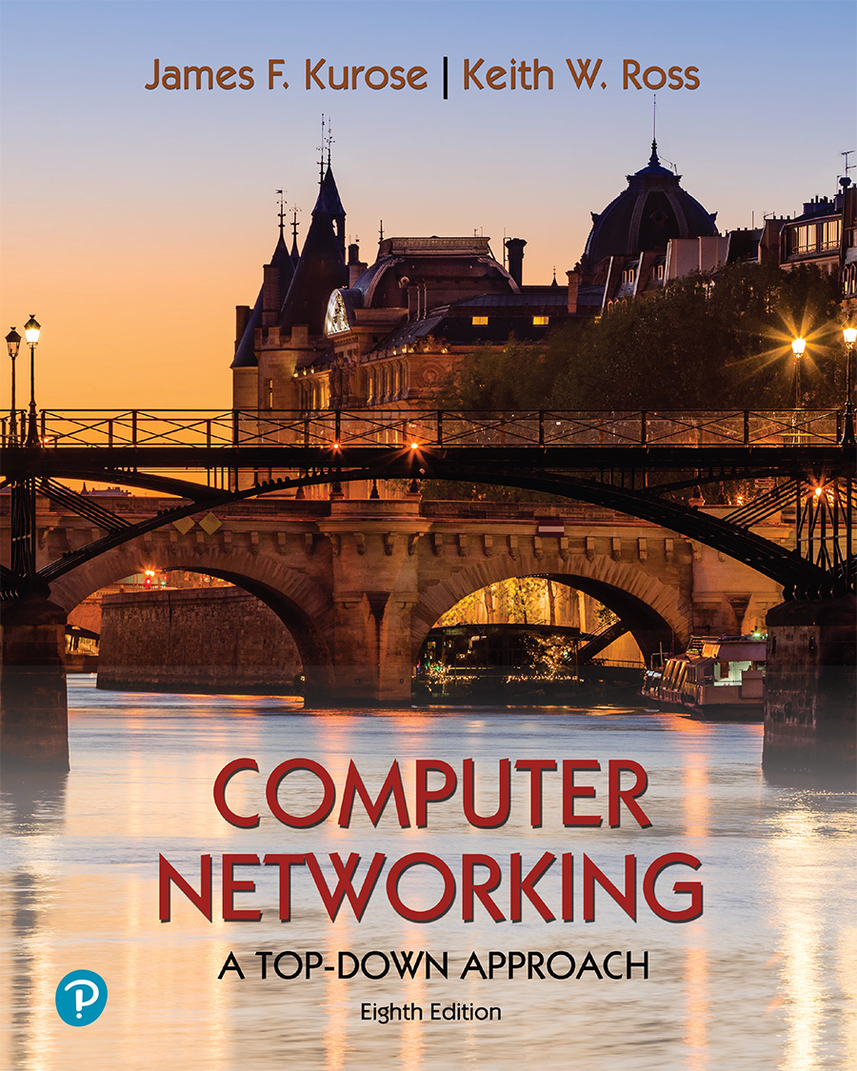
Chapter 5 Network Layer:
Control Plane
A note on the use of these PowerPoint slides:
We’re making these slides freely available to all (faculty, students, readers). They’re in PowerPoint form so you see the animations; and can add, modify, and delete slides (including this one) and slide content to suit your needs. They obviously represent a lot of work on our part. In return for use, we only ask the following:
If you use these slides (e.g., in a class) that you mention their source (after all, we’d like people to use our book!)
If you post any slides on a www site, that you note that they are adapted from (or perhaps identical to) our slides, and note our copyright of this material.
For a revision history, see the slide note for this page.
Thanks and enjoy! JFK/KWR
All material copyright 1996-2023
J.F Kurose and K.W. Ross, All Rights Reserved
Computer Networking: A Top-Down Approach 8th edition Jim Kurose, Keith Ross Pearson, 2020
Notes:
Version History
8.0 (May 2020)
All slides reformatted for 16:9 aspect ratio
All slides updated to 8th edition material
Use of Calibri font, rather that Gill Sans MT
Add LOTS more animation throughout
lighter header font
Re-do of network management slides; redo of Bellman-Ford slides
8.2 (changes over 8.0)
improved animations of Dijkstra’s algorithm and Bellman Ford
various improvements to BGP
SDN: added Google Orion (2021 Google network SDN control plane)

Slide 24
Network layer control plane: our goals
understand principles behind network control plane:
traditional routing algorithms
SDN controllers
network management, configuration
instantiation, implementation in the Internet:
OSPF, BGP
OpenFlow, ODL and ONOS controllers
Internet Control Message Protocol: ICMP
SNMP, YANG/NETCONF

Slide 25
Network layer: “control plane” roadmap
introduction
routing protocols
link state
distance vector
intra-ISP routing: OSPF
routing among ISPs: BGP
SDN control plane
Internet Control Message Protocol
network management, configuration
SNMP
NETCONF/YANG

Slide 26
Network-layer functions
forwarding: move packets from router’s input to appropriate router output
data plane
routing: determine route taken by packets from source to destination
control plane
Two approaches to structuring network control plane:
per-router control (traditional)
logically centralized control (software defined networking)

Slide 27

Per-router control plane
Individual routing algorithm components in each and every router interact in the control plane
Routing
Algorithm
control
plane
data
plane
values in arriving
packet header
0111
1
3
2

Slide 28
Software-Defined Networking (SDN) control plane
Remote controller computes, installs forwarding tables in routers
Remote Controller
control
plane
data
plane
CA
CA
CA
CA
CA
values in arriving
packet header
0111
1
3
2

Slide 29
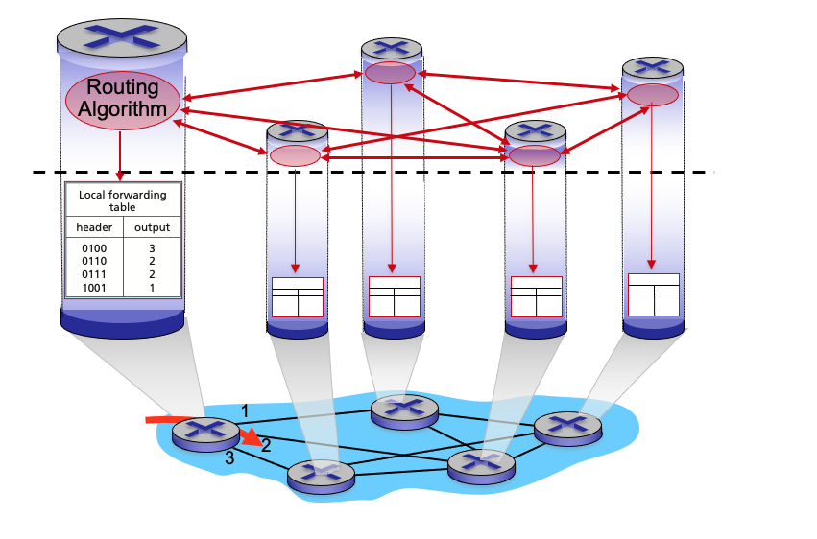
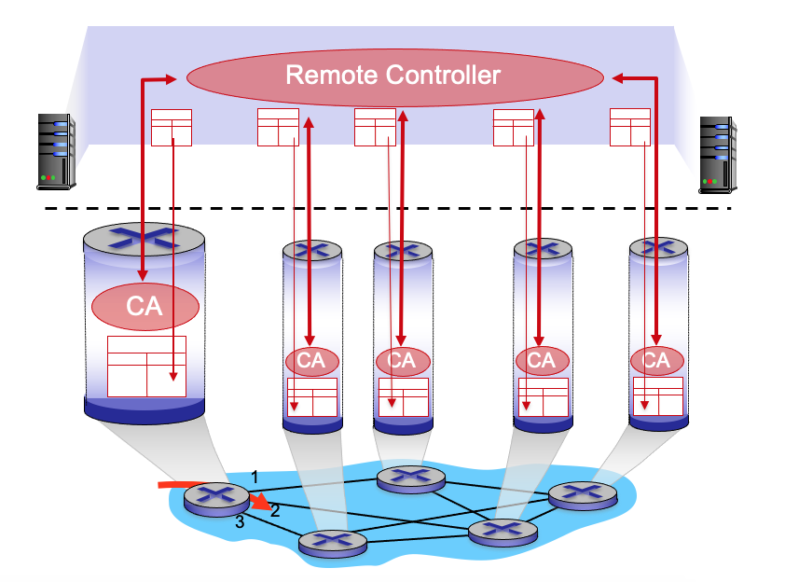
Per-router control plane
SDN control plane

Slide 30
Network layer: “control plane” roadmap
introduction
routing protocols
link state
distance vector
intra-ISP routing: OSPF
routing among ISPs: BGP
SDN control plane
Internet Control Message Protocol
network management, configuration
SNMP
NETCONF/YANG

Slide 31
Routing protocols
mobile network
Routing protocol goal: determine “good” paths (equivalently, routes), from sending hosts to receiving host, through network of routers
path: sequence of routers packets traverse from given initial source host to final destination host
“good”: least “cost”, “fastest”, “least congested”
routing: a “top-10” networking challenge!
national or global ISP
application
transport
network
link
physical
network
link
physical
network
link
physical
network
link
physical
network
link
physical
network
link
physical
datacenter
network
application
transport
network
link
physical
enterprise
network

Slide 32
Graph abstraction: link costs
5
c_{a,b}: cost of direct link connecting a and b
e.g., c_{w,z} = 5, c_{u,z} = ∞
cost defined by network operator: could always be 1, or inversely related to bandwidth, or inversely related to congestion
v
3
w
2
5
u
2
1
z
3
1
2
x
y
1
graph: G = (N,E)
N: set of routers = { u, v, w, x, y, z }
E: set of links ={ (u,v), (u,x), (v,x), (v,w), (x,w), (x,y), (w,y), (w,z), (y,z) }

Slide 33
Routing algorithm classification
global: all routers have complete topology, link cost info
“link state” algorithms
dynamic: routes change more quickly
periodic updates or in response to link cost changes
How fast do routes change?
static: routes change slowly over time
decentralized: iterative process of computation, exchange of info with neighbors
routers initially only know link costs to attached neighbors
“distance vector” algorithms
global or decentralized information?

Slide 34
Network layer: “control plane” roadmap
introduction
routing protocols
link state
distance vector
intra-ISP routing: OSPF
routing among ISPs: BGP
SDN control plane
Internet Control Message Protocol
network management, configuration
SNMP
NETCONF/YANG

Slide 35
Dijkstra’s link-state routing algorithm
centralized: network topology, link costs known to all nodes
accomplished via “link state broadcast”
all nodes have same info
computes least cost paths from one node (“source”) to all other nodes
gives forwarding table for that node
iterative: after k iterations, know least cost path to k destinations
notation
c_{x,y}: direct link cost from node x to y; = ∞ if not direct neighbors
D(v): current estimate of cost of least-cost-path from source to destination v
p(v): predecessor node along path from source to v
N': set of nodes whose least-cost-path definitively known

Slide 36
Dijkstra’s link-state routing algorithm
1 Initialization:
2 N' = {u} /* compute least cost path from u to all other nodes */
3 for all nodes v
4 if v adjacent to u /* u initially knows direct-path-cost only to direct neighbors */
5 then D(v) = c_{u,v} /* but may not be minimum cost! */
6 else D(v) = ∞
7
8 Loop
9
10
11
12
13
14
15 until all nodes in N'
find w not in N' such that D(w) is a minimum
add w to N'
update D(v) for all v adjacent to w and not in N' :
D(v) = min ( D(v), D(w) + c_{w,v} )
/* new least-path-cost to v is either old least-cost-path to v or known
least-cost-path to w plus direct-cost from w to v */

Slide 37
Dijkstra’s algorithm: an example
v
w
x
y
z
Step
0
1
2
3
4
5
N'
D(v),p(v)
D(w),p(w)
D(x),p(x)
D(y),p(y)
D(z),p(z)
u
2,u
5,u
1,u
∞
∞
D(w),p(w)
5,u
4,x
3,y
3,y
5
Initialization (step 0):
For all a: if a adjacent to u then D(a) = c_{u,a}
v
3
w
2
5
u
2
1
z
3
1
2
x
y
1

Slide 38
Dijkstra’s algorithm: an example
v
w
x
y
z
Step
0
1
2
3
4
5
N'
D(v),p(v)
D(w),p(w)
D(x),p(x)
D(y),p(y)
D(z),p(z)
u
2,u
5,u
1,u
∞
∞
ux
D(w),p(w)
5,u
4,x
3,y
3,y
8 Loop
9
10
find a not in N' such that D(a) is a minimum
add a to N'
5
v
3
w
2
5
u
2
1
z
3
1
2
x
y
1

Slide 39

Dijkstra’s algorithm: an example
v
w
x
y
z
Step
0
1
2
3
4
5
N'
D(v),p(v)
D(w),p(w)
D(x),p(x)
D(y),p(y)
D(z),p(z)
u
2,u
5,u
1,u
∞
∞
ux
2,u
4,x
2,x
∞
D(w),p(w)
5,u
4,x
3,y
3,y
8 Loop
9
10
11
find a not in N' such that D(a) is a minimum
add a to N'
5
v
3
w
2
5
update D(b) for all b adjacent to a and not in N' :
D(b) = min ( D(b), D(a) + c_{a,b} )
u
2
1
z
3
1
2
D(v) = min ( D(v), D(x) + c_{x,v} ) = min(2, 1+2) = 2
x
y
1
D(w) = min ( D(w), D(x) + c_{x,w} ) = min (5, 1+3) = 4
D(y) = min ( D(y), D(x) + c_{x,y} ) = min(inf,1+1) = 2

Slide 40
Dijkstra’s algorithm: an example
v
w
x
y
z
Step
0
1
2
3
4
5
N'
D(v),p(v)
D(w),p(w)
D(x),p(x)
D(y),p(y)
D(z),p(z)
u
2,u
5,u
1,u
∞
∞
ux
2,u
4,x
2,x
∞
uxy
D(w),p(w)
5,u
4,x
3,y
3,y
8 Loop
9
10
find a not in N' such that D(a) is a minimum
add a to N'
5
v
3
w
2
5
u
2
1
z
3
1
2
x
y
1

Slide 41
Dijkstra’s algorithm: an example
v
w
x
y
z
Step
0
1
2
3
4
5
N'
D(v),p(v)
D(w),p(w)
D(x),p(x)
D(y),p(y)
D(z),p(z)
u
2,u
5,u
1,u
∞
∞
ux
2,u
4,x
2,x
∞
uxy
2,u
3,y
4,y
8 Loop
9
10
11
find a not in N' such that D(a) is a minimum
add a to N'
5
v
3
w
2
5
update D(b) for all b adjacent to a and not in N' :
D(b) = min ( D(b), D(a) + c_{a,b} )
u
2
1
z
3
1
2
D(w) = min ( D(w), D(y) + c_{y,w} ) = min (4, 2+1) = 3
x
y
1
D(z) = min ( D(z), D(y) + c_{y,z} ) = min(inf,2+2) = 4

Slide 42
Dijkstra’s algorithm: an example
v
w
x
y
z
Step
0
1
2
3
4
5
N'
D(v),p(v)
D(w),p(w)
D(x),p(x)
D(y),p(y)
D(z),p(z)
u
2,u
5,u
1,u
∞
∞
ux
2,u
4,x
2,x
∞
uxy
2,u
3,y
4,y
uxyv
8 Loop
9
10
find a not in N' such that D(a) is a minimum
add a to N'
5
v
3
w
2
5
u
2
1
z
3
1
2
x
y
1

Slide 43
Dijkstra’s algorithm: an example
v
w
x
y
z
Step
0
1
2
3
4
5
N'
D(v),p(v)
D(w),p(w)
D(x),p(x)
D(y),p(y)
D(z),p(z)
u
2,u
5,u
1,u
∞
∞
ux
2,u
4,x
2,x
∞
uxy
2,u
3,y
4,y
uxyv
3,y
4,y
8 Loop
9
10
11
find a not in N' such that D(a) is a minimum
add a to N'
5
v
3
w
2
5
update D(b) for all b adjacent to a and not in N' :
D(b) = min ( D(b), D(a) + c_{a,b} )
u
2
1
z
3
1
2
D(w) = min ( D(w), D(v) + c_{v,w} ) = min (3, 2+3) = 3
x
y
1

Slide 44
Dijkstra’s algorithm: an example
v
w
x
y
z
Step
0
1
2
3
4
5
N'
D(v),p(v)
D(w),p(w)
D(x),p(x)
D(y),p(y)
D(z),p(z)
u
2,u
5,u
1,u
∞
∞
ux
2,u
4,x
2,x
∞
uxy
2,u
3,y
4,y
uxyv
3,y
4,y
uxyvw
8 Loop
9
10
find a not in N' such that D(a) is a minimum
add a to N'
5
v
3
w
2
5
u
2
1
z
3
1
2
x
y
1

Slide 45
Dijkstra’s algorithm: an example
v
w
x
y
z
Step
0
1
2
3
4
5
N'
D(v),p(v)
D(w),p(w)
D(x),p(x)
D(y),p(y)
D(z),p(z)
u
2,u
5,u
1,u
∞
∞
ux
2,u
4,x
2,x
∞
uxy
2,u
3,y
4,y
uxyv
3,y
4,y
uxyvw
4,y
8 Loop
9
10
11
find a not in N' such that D(a) is a minimum
add a to N'
5
v
3
w
2
5
update D(b) for all b adjacent to a and not in N' :
D(b) = min ( D(b), D(a) + c_{a,b} )
u
2
1
z
3
1
2
D(z) = min ( D(z), D(w) + c_{w,z} ) = min (4, 3+5) = 4
x
y
1

Slide 46
Dijkstra’s algorithm: an example
v
w
x
y
z
Step
0
1
2
3
4
5
N'
D(v),p(v)
D(w),p(w)
D(x),p(x)
D(y),p(y)
D(z),p(z)
u
2,u
5,u
1,u
∞
∞
ux
2,u
4,x
2,x
∞
uxy
2,u
3,y
4,y
uxyv
3,y
4,y
uxyvw
4,y
uxyvwz
8 Loop
9
10
find a not in N' such that D(a) is a minimum
add a to N'
5
v
3
w
2
5
u
2
1
z
3
1
2
x
y
1

Slide 47
Dijkstra’s algorithm: an example
v
w
x
y
z
Step
0
1
2
3
4
5
N'
D(v),p(v)
D(w),p(w)
D(x),p(x)
D(y),p(y)
D(z),p(z)
u
2,u
5,u
1,u
∞
∞
ux
2,u
4,x
2,x
∞
uxy
2,u
3,y
4,y
uxyv
3,y
4,y
uxyvw
4,y
uxyvwz
8 Loop
9
10
11
find a not in N' such that D(a) is a minimum
add a to N'
5
v
3
w
2
5
update D(b) for all b adjacent to a and not in N' :
D(b) = min ( D(b), D(a) + c_{a,b} )
u
2
1
z
3
1
2
x
y
1

Slide 48
Dijkstra’s algorithm: an example
v
w
x
y
z
Step
0
1
2
3
4
5
N'
D(v),p(v)
D(w),p(w)
D(x),p(x)
D(y),p(y)
D(z),p(z)
u
2,u
5,u
1,u
∞
∞
ux
2,u
4,x
2,x
∞
uxy
2,u
3,y
4,y
uxyv
3,y
4,y
D(w),p(w)
5,u
4,x
3,y
3,y
uxyvw
4,y
uxyvwz
Initialization (step 0): For all a: if a adjacent to then D(a) = c_{u,a}
5
find a not in N' such that D(a) is a minimum
add a to N'
update D(b) for all b adjacent to a and not in N' :
D(b) = min ( D(b), D(a) + c_{a,b} )
v
3
w
2
5
u
2
1
z
3
1
2
x
y
1

Slide 49
Dijkstra’s algorithm: an example
5
v
3
w
2
5
u
2
1
z
3
1
2
D(w),p(w)
5,u
4,x
3,y
3,y
x
y
1
resulting least-cost-path tree from u:
resulting forwarding table in u:
v
w
destination
outgoing link
v
x
y
w
x
(u,v)
(u,x)
(u,x)
(u,x)
(u,x)
route from u to v directly
u
z
x
route from u to all other destinations via x
y

Slide 50
Dijkstra’s algorithm: another example
v
w
x
y
z
x
D(v),
p(v)
D(w),
p(w)
D(x),
p(x)
D(y),
p(y)
D(z),
p(z)
9
Step
N'
0
u
7,u
3,u
5,u
∞
∞
5
7
4
1
uw
6,w
5,u
11,w
∞
8
2
uwx
6,w
11,w
14,x
u
3
w
y
z
2
3
uwxv
10,v
14,x
3
4
uwxvy
12,y
7
4
5
uwxvyz
v
notes:
construct least-cost-path tree by tracing predecessor nodes
ties can exist (can be broken arbitrarily)

Slide 51
Dijkstra’s algorithm: discussion
algorithm complexity: n nodes
each of n iteration: need to check all nodes, w, not in N
n(n+1)/2 comparisons: O(n²) complexity
more efficient implementations possible: O(nlogn)
message complexity:
each router must broadcast its link state information to other n routers
efficient (and interesting!) broadcast algorithms: O(n) link crossings to disseminate a broadcast message from one source
each router’s message crosses O(n) links: overall message complexity: O(n²)

Slide 52
Dijkstra’s algorithm: oscillations possible
when link costs depend on traffic volume, route oscillations possible
sample scenario:
routing to destination a, traffic entering at d, c, e with rates 1, e (<1), 1
link costs are directional, and volume-dependent
a
a
a
a
1
1+e
2+e
0
0
2+e
2+e
0
d
b
d
1
b
d
b
d
b
0
0
1+e
0
0
1+e
1
1
0
e
1
0
c
0
1
1
1
c
1+e
1
1
0
0
1
c
1
c
e
e
e
e
given these costs,
find new routing….
resulting in new costs
given these costs,
find new routing….
resulting in new costs
given these costs,
find new routing….
resulting in new costs
initially

Slide 53
Summary
Routing Protocol
Dijkstra’s algorithm

Slide 54
Questions?

Slide 55
Thank You

